Slide 1


Paper 197: A Novel Sensitivity Analysis Method Using Self-Organizing Maps (SOM) Deepanshu and Palaniappan Ramu
15th World Congress on Structural and Multidisciplinary Optimization | WCSMO 2023
$Advanced Design, Optimization, & Probabilistic Techniques (ADOPT) Laboratory
Department of Engineering Design
Indian Institute of Technology Madras
Chennai, India

Slide 2
Content
Sensitivity Analysis
Current Challenges
Curse of Dimensionality
Limited Budget
Discontinuity
Self-Organizing Map (SOM)
SOM for Meta-modeling
SOM for Sensitivity Analysis
Results and Discussion
Summary and Future Work

Slide 3
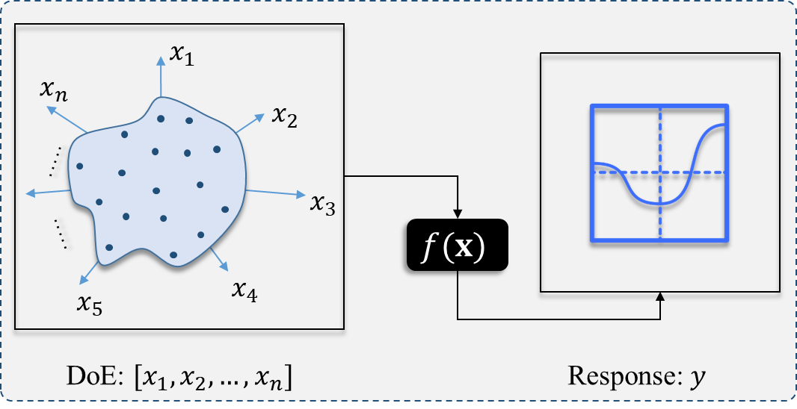
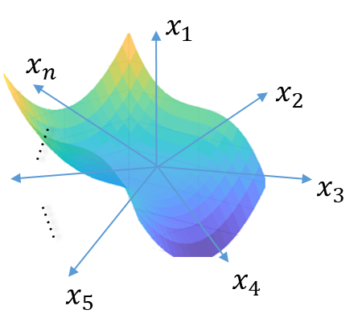

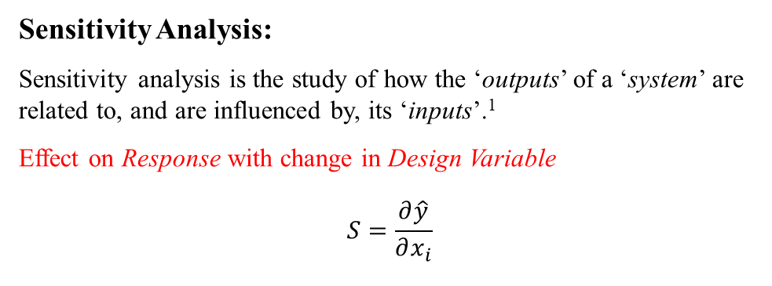
Surrogate-assisted Sensitivity Analysis
Sensitivity Analysis:
Sensitivity analysis is the study of how the ‘outputs’ of a ‘system’ are related to, and are influenced by, its ‘inputs’.¹
Effect on Response with change in Design Variable
$$S=\frac{∂\hat{y}}{∂x_{i}}$$
Application of Sensitivity Analysis¹:
Interaction between design variable(s) and response
Feature and structure selection and ranking in ML
Decision support system, MCDM
Multi-disciplinary optimization, etc.
Sensitivity
Analysis Tool
Sensitivity
Analysis
Surrogate model
Fig. General framework of surrogate-assisted Sensitivity Analysis
Razavi, Saman, et al. "The future of sensitivity analysis: An essential discipline for systems modeling and policy support." Environmental Modelling & Software 137 (2021): 104954.

Slide 4
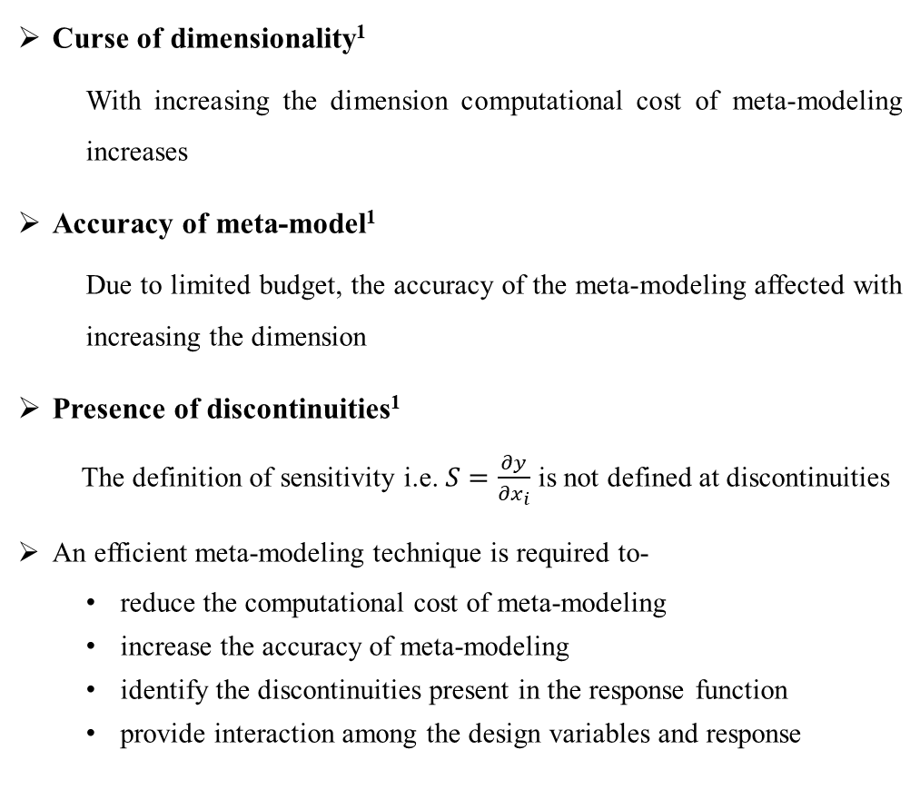
Current Challenges
Curse of dimensionality¹
With increasing the dimension computational cost of meta-modeling increases
Accuracy of meta-model¹
Due to limited budget, the accuracy of the meta-modeling affected with increasing the dimension
Presence of discontinuities¹
The definition of sensitivity i.e. $S=\frac{∂y}{∂x_{i}}$ is not defined at discontinuities
An efficient meta-modeling technique is required to-
reduce the computational cost of meta-modeling
increase the accuracy of meta-modeling
identify the discontinuities present in the response function
provide interaction among the design variables and response
Number of coefficients (a)
Dimensions (n)
Figure: Computational Cost for PRS
f (x)
f (x)
Actual
Predicted
A
B
x
x = x₀
x
1. Cheng, Kai, et al. "Surrogate-assisted global sensitivity analysis: an overview." Structural and Multidisciplinary Optimization 61 (2020): 1187-1213.
Figure: Error in meta-modeling
Figure: Discontinuous function

Slide 5
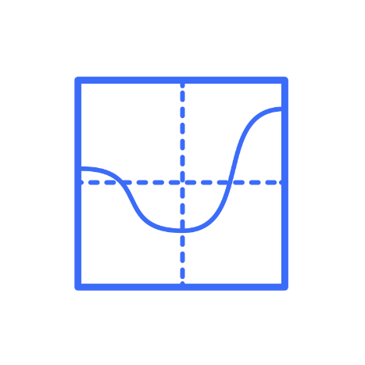
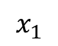

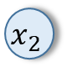


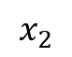
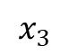
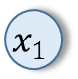
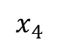

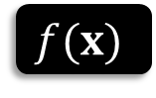
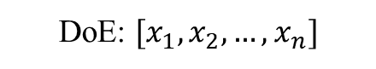

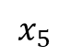


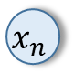
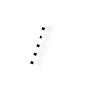
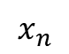

Self-Organizing Maps (SOM) 1/2
$$x_{1}$$
$$x_{1}$$
$$x_{n}$$
$$w_{1}$$
$$x_{2}$$
$$x_{2}$$
$$. . . ..$$
$$w_{2}$$
$$x_{3}$$
$$. . . ..$$
$$. . . ..$$
$$f(x)$$
$$. . . ..$$
$$x_{5}$$
$$x_{4}$$
$$x_{n}$$
$$w_{M}$$
$$y$$
DoE: $[x_{1},x_{2},…, x_{n}]$
Response: $y$
Input data to SOM
Training SOM
SOM Grid
Figure: Working principle of Self-Organizing Maps (SOM)
Kohonen, Teuvo. "The self-organizing map." Proceedings of the IEEE 78.9 (1990): 1464-1480.

Slide 6
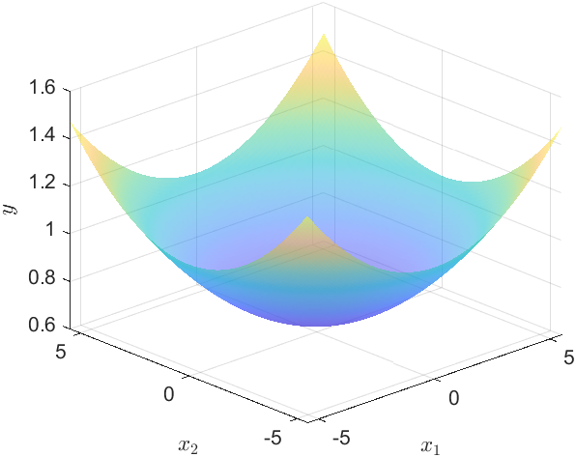
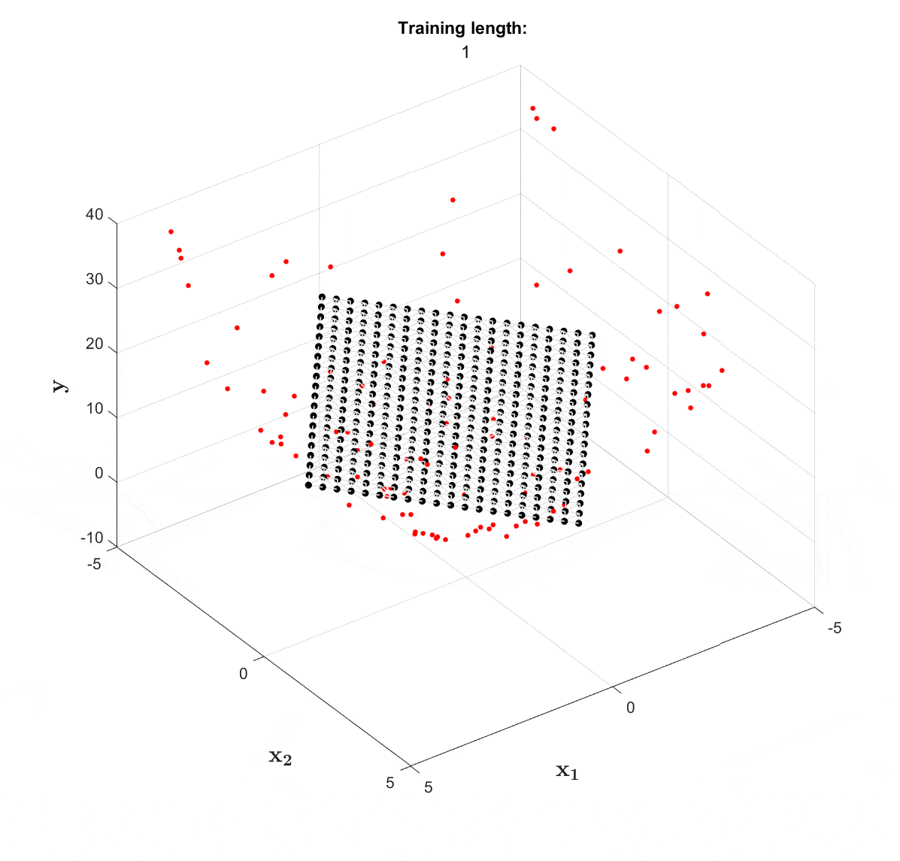
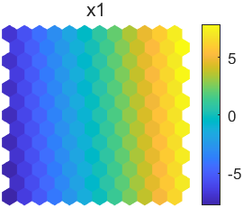
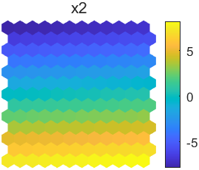
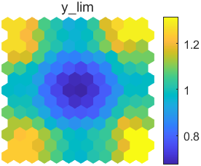
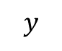
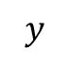
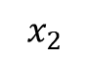
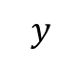
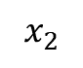
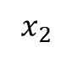
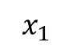
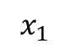

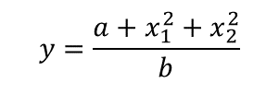
Self-Organizing Maps (SOM) 2/2
$$y=\frac{{a+x}_{1}^{2}+x_{2}^{2}}{b}$$
Initialization:
Random
Linear
Training:
BMU calculation
Weight update
$$y$$
$$x_{1}$$
$$x_{2}$$
$$y$$
$$x_{1}$$
$$x_{2}$$
$$y$$
45
30
$$x_{2}$$
$$x_{1}$$
15
Figure: Input variables and response representation through Self-Organizing Maps (SOM)
Thole, Sidhant Pravinkumar, and Palaniappan Ramu. "Design space exploration and optimization using self-organizing maps." Structural and Multidisciplinary Optimization 62.3 (2020): 1071-1088.

Slide 7
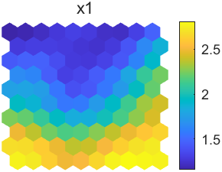
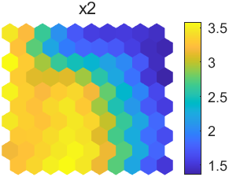
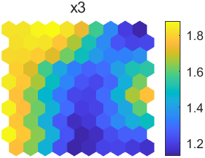
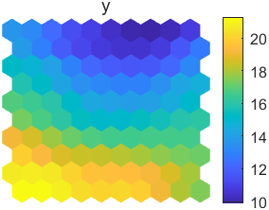
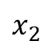
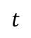
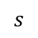
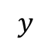
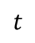
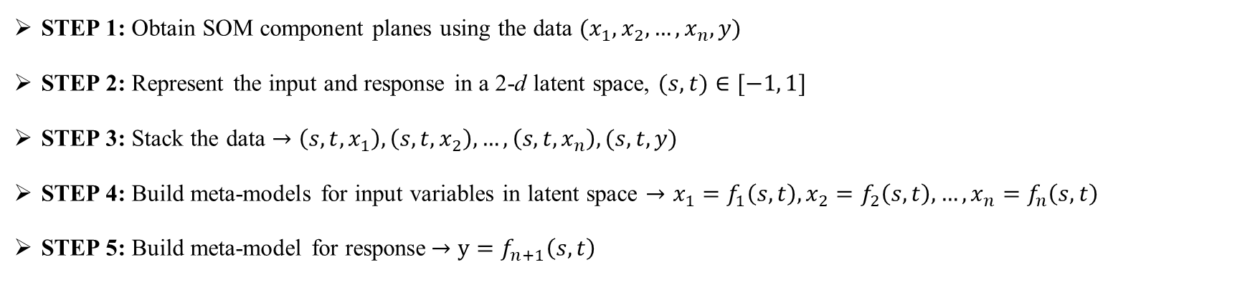
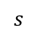
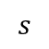
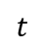
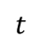
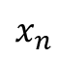
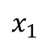
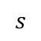
Proposed Methodology 1/2
SOM-assisted Meta-modeling
$$t$$
$$x_{1}$$
$$t$$
$$x_{2}$$
$$t$$
$$x_{n}$$
$$t$$
$$y$$
……
(0,0,3)
(0,0,3.25)
(0,0,1.7)
(0,0,21)
$$s$$
$$s$$
$$s$$
$$s$$
Figure: Self-Organizing Maps (SOM) assisted Meta-modeling
STEP 1: Obtain SOM component planes using the data $(x_{1}, x_{2}, …, x_{n}, y)$
STEP 2: Represent the input and response in a 2-d latent space, $(s,t)∈[−1, 1]$
STEP 3: Stack the data $→\left(s,t,x_{1}\right), \left(s,t,x_{2}\right), …,\left(s,t,x_{n}\right), (s,t,y)$
STEP 4: Build meta-models for input variables in latent space $→x_{1}=f_{1}\left(s,t\right),x_{2}=f_{2}\left(s,t\right),…,x_{n}=f_{n}\left(s,t\right)$
STEP 5: Build meta-model for response$→y=f_{n+1}\left(s,t\right)$

Slide 8

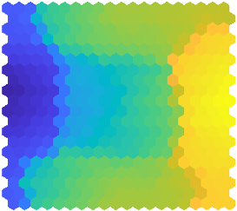
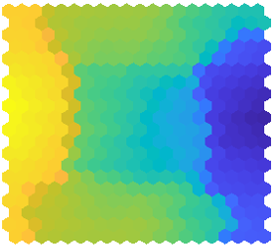







Proposed Methodology 2/2
SOM-assisted Sensitivity Analysis
Given: Data $(x_{1}, x_{2}, …, x_{n}, y)$
${x_{1}=f_{1}\left(s,t\right),x_{2}=f_{2}\left(s,t\right),…,x}_{n}=f_{n}\left(s,t\right);$
$y=f_{n+1}\left(s,t\right); \left(s,t\right)∈[−1, 1]$
Sensitivity Analysis:
Applying chain-rule
$${\left[\frac{∂y}{∂s}\right]}_{ }=\sum{\left(\frac{∂y}{∂x_{i}}\right)\left(\frac{∂x_{i}}{∂s}\right)}$$
$${\left[\frac{∂y}{∂t}\right]}_{ }=\sum{\left(\frac{∂y}{∂x_{i}}\right)\left(\frac{∂x_{i}}{∂t}\right)}$$
Sensitivity analysis through latent space
$$\left\{\begin{matrix}\frac{∂y}{∂s} \\ \begin{aligned} \\ \end{aligned} \\ \frac{∂y}{∂t}\end{matrix}\right\}=\left[\begin{matrix}\frac{∂x_{1}}{∂s} & \frac{∂x_{2}}{∂s} ⋯ & \frac{∂x_{n}}{∂s} \\ & & \\ \frac{∂x_{1}}{∂t} & \frac{∂x_{2}}{∂t} ⋯ & \frac{∂x_{n}}{∂t}\end{matrix}\right] \left\{\begin{matrix}\frac{∂y}{∂x_{1}} \\ \begin{aligned}\frac{∂y}{∂x_{2}} \\ ⋮\end{aligned} \\ \frac{∂y}{∂x_{n}}\end{matrix}\right\}$$
$${\left\{Δy\right\}}_{x_{i}}={{\left[ J\right]}_{X}}^{†} {\left\{J\right\}}_{Y}$$
Where,${{\left[ J\right]}_{X}}^{†}$ is the pseudo inverse of the Jacobian Matrix ${\left[ J\right]}_{X}$
Design variable dimension vs. Computational cost
Data: [x y]
PRS Model:
Number of coefficient (a) to be estimated = $^{n+r}C_{r}$
Without using SOM = $^{n+r}C_{r}$
Using SOM = $^{2+r}C_{r}×(1+n)$
SOM Component Plane (s , t)
Mapping
x₁(s , t)
x₂(s , t) …
y (s , t)
$$\left(x,y\right)↔(s,t)$$
Meta-modeling in SOM space
Input $(x_{0},y_{0})$
$${\left\{J\right\}}_{Y}$$
$${\left\{Δy\right\}}_{x_{i}}$$
Jacobian computation in SOM space
Obtain ($s, t$)
Sensitivity Analysis
Figure: Computational Cost (PRS degree r =2)
Fig. Proposed approach for SOM-assisted sensitivity analysis

Slide 9















Results 1/6 | Sphere Function
Benchmark Example
Sphere function¹:
$$y=x_{1}^{2}+x_{2}^{2};$$
$$y^{′}=[2x_{1}, 2x_{2}]$$
$$x_{1}\sim U[−1.5,1.5], { x}_{2}\sim U[−1.5,1.5]$$
Inferences:
SOM plot provides essential information on response and variable interaction
Response $y$ is equally sensitive to the variable $x_{2}$ and$x_{1}$
SOM-based meta-model provides good fit and sensitivity information
$$t$$
$$x_{1}$$
$$t$$
$$x_{2}$$
$$t$$
$$y$$
A
B
A
B
A
B
E
E
E
Fig: Meta-model accuracy
D
C
D
C
D
C
$$s$$
$$s$$
$$s$$
Fig: SOM plots for Sphere function
Fig: Sensitivity information (-1,-1) to (1,1)
Molga, M., & Smutnicki, C. Test functions for optimization needs (2005). Retrieved June 2013, from http://www.zsd.ict.pwr.wroc.pl/files/docs/functions.pdf

Slide 10















Results 2/6 | Webster Function
Benchmark Example
Webster et al. (1996) function¹:
$$y=x_{1}^{2}+x_{2}^{3};$$
$$y^{′}=[2x_{1}, 3x_{2}^{2}]$$
$$x_{1}\sim U[1,10], { x}_{2}\sim U(−1,6)$$
Inferences:
Response $y$ is more sensitive to the variable $x_{2}$ than the variable $x_{1}$
SOM-based meta-model provides good fit and sensitivity information
This sensitivity information can be used for feature selection
$$t$$
$$x_{1}$$
$$t$$
$$x_{2}$$
$$t$$
$$y$$
A
A
A
Fig: Meta-model accuracy
B
B
B
$$s$$
$$s$$
$$s$$
Fig: SOM plots for Webster et al. (1996) function
Fig: Sensitivity information
Webster, M. D., Tatang, M. A., & McRae, G. J. (1996). Application of the probabilistic collocation method for an uncertainty analysis of a simple ocean model

Slide 11















Results 2/6 | Webster Function
Benchmark Example
Webster et al. (1996) function¹:
$$y=x_{1}^{2}+x_{2}^{3}$$
$$y^{′}=[2x_{1}, 3x^{2}]$$
$$x_{1}\sim U[−1,1], { x}_{2}\sim U[−1,1]$$
Inferences:
Response $y$ is more sensitive to the variable $x_{2}$ than the variable $x_{1}$
SOM-based meta-model provides good fit and sensitivity information
This sensitivity information can be used to quantify the non-linearity
A
B
$$t$$
$$x_{1}$$
$$t$$
$$x_{2}$$
$$t$$
$$y$$
A
B
A
B
A
B
C
Fig: Webster function
C
C
C
$$s$$
$$s$$
$$s$$
Fig: SOM plots for Webster et al. (1996) function
Fig: Sensitivity information (-1,-1) to (1,1)
Webster, M. D., Tatang, M. A., & McRae, G. J. (1996). Application of the probabilistic collocation method for an uncertainty analysis of a simple ocean model

Slide 12











Results 3/6 | Short Column
Engineering Example
Short Column function¹:
$$y_{lim}=1 −\frac{4M}{bh^{2}Y}−\frac{P^{2}}{b^{2}h^{2}Y^{2}}; b=5, h=15$$
$$Y\sim log−N\left(5,0.5\right), M\sim N\left(2000,400\right), P\sim N(500,100)$$
Inferences:
Limit state function ($y_{lim}$) is positively correlated with Yield strength ($Y$) of material
$y_{lim}$ is negatively correlated to moment of inertia ($I$) and applied load ($P$)
SOM-based meta-model provides good fit and sensitivity information
$$Y$$
$$M$$
$$P$$
$$y_{lim}$$
Fig: Meta-model accuracy
Fig: SOM plots for Short Column function
Kuschel, N., & Rackwitz, R. (1997). Two basic problems in reliability-based structural optimization. Mathematical Methods of Operations Research, 46(3), 309-333
Fig: Sensitivity information

Slide 13













Results 4/6 | Knee Point in Pareto Front
Knee Point Identification
Naru-Weiss problem¹:
Inferences:
Near the knee point region, objective function $f_{5}$ is more sensitive
Near the knee point region, $f_{5}$ sensitivity order-
$${\left(\frac{δf_{5}}{δf_{3}}\right)}^{+}>{\left(\frac{δf_{5}}{δf_{1}}\right)}^{−}>{\left(\frac{δf_{5}}{δf_{4}}\right)}^{+}>{\left(\frac{δf_{5}}{δf_{2}}\right)}^{+}$$
This information is crucial in multi-criteria decision making (MCDM)
$$f_{1}$$
$$f_{2}$$
$$f_{3}$$
$$f_{4}$$
$$f_{5}$$
Knee point
region
A
Fig: SOM plots for Naru-Weiss Problem
Knee point
region
A
Knee Point
Miettinen, K., and M. M. Mäkelä. "Interactive bundle-based method for non-differentiable multi-objeective optimization: NIMBUS." Optimization 34.3 (1995): 231-246.
Fig: Pareto front of Naru-Weiss problem
Fig: Knee point sensitivity information

Slide 14












Results 5/6 | Disjoint Pareto Front
Sensitivity Analysis of Pareto Front
DPF-4 problem¹:
Inferences:
Objective $f_{1}$ and $f_{4}$ share negative correlation
Objective $f_{4}$ is more sensitive to $f_{1}$ as compared to the objectives $f_{2}$ and $f_{3}$
The above information is crucial in reference direction-based MCDM
$$f_{1}$$
$$f_{2}$$
$$f_{3}$$
$$f_{4}$$
C
P
P
P
P
D
A
B
O
O
O
O
E
Q
Q
Q
Q
Fig: SOM plots for DPF-4
P
P
Direction | OP | OQ
$$f_{1}$$ | $$↓$$ | $$↑$$
$$f_{2}$$ | $$↑$$ | $$↑$$
$$f_{3}$$ | $$↑$$ | $$↑$$
$$f_{4}$$ | $$↑$$ | $$↓$$
O
O
Q
Q
Yadav, Deepanshu, et al. "Visualization-aided multi-criteria decision-making using interpretable self-organizing maps." European Journal of Operational Research 309.3 (2023): 1183-1200.
Fig. Disjoint Pareto Front
Fig: Sensitivity information in region ‘A’

Slide 15

Results 6/6 | High-dimension Problem
Real-world Problem
General Aviation Aircraft¹:
10 Objective functions and 27 design variables
SOM-Kriging meta-models require less number of parameter estimation, hence requires less computational cost
SOM-Kriging meta-models are more suitable for sensitivity analysis
Table: SOM-assisted meta-modeling on General Aviation Aircraft problem demonstrating the effectiveness of proposed approach for high dimensional problem
$$Function$$ | $$Ideal Point$$ | $$Nadir Point$$ | $$Range$$ | SOM-Kriging |  |  |  |  | Kriging
 |  |  |  | X-val: Uniform Samples |  | X-val: LHS |  | % PrESS RMSE/Range | X-val: Pareto Optimal Solutions
 |  |  |  | RMSE | % RMSE/Range | RMSE | % RMSE/Range |  | RMSE | % RMSE/ Range | % PrESS RMS/Range
$$f_{1}$$ | $$73.18$$ | $$\text{75.2}\text{4}$$ | $$\text{2.0}\text{5}$$ | $$\text{0.}\text{31}$$ | $$15.14$$ | 0.29 | 14.07 | 18.97 | 0.65 | 31.59 | 28.65
$$f_{2}$$ | $$\text{1826.54}$$ | $$\text{2154.9}\text{2}$$ | $$\text{328.37}$$ | $$\text{16.46}$$ | $$5.012$$ | 15.84 | 4.82 | 7.52 | 84.39 | 25.70 | 24.46
$$f_{3}$$ | $$\text{54.22}$$ | $$\text{97.3}\text{1}$$ | $$\text{43.08}$$ | $$\text{2.92}$$ | $$6.78$$ | 2.84 | 6.59 | 14.72 | 10.65 | 24.73 | 22.84
$$f_{4}$$ | $$\text{1.76}$$ | $$\text{2.61}$$ | $$\text{0.8}\text{5}$$ | $$\text{0.05}$$ | $$6.30$$ | 0.05 | 5.39 | 11.05 | 0.207 | 24.51 | 24.11
$$f_{5}$$ | $$\text{231.32}$$ | $$\text{552.1}\text{9}$$ | $$\text{320.8}\text{7}$$ | $$\text{15.76}$$ | $$4.91$$ | 10.53 | 3.28 | 7.51 | 77.68 | 24.21 | 23.10
$$f_{6}$$ | $$\text{41324.27}$$ | $$\text{47912.6}\text{2}$$ | $$\text{6588.3}\text{4}$$ | $$\text{312.21}$$ | $$4.73$$ | 291.21 | 4.42 | 7.41 | 1580 | 23.99 | 22.56
$$f_{7}$$ | $$\text{−}\text{3121.66}$$ | $$\text{−883.56}$$ | $$\text{2238.09}$$ | $$\text{17}\text{5.79}$$ | $$7.85$$ | 183.01 | 8.18 | 11.21 | 478.72 | 21.38 | 20.57
$$f_{8}$$ | $$\text{−}\text{20.64}$$ | $$\text{−13.97}$$ | $$\text{6.66}$$ | $$\text{0.45}$$ | $$6.75$$ | 0.47 | 7.07 | 9.96 | 1.58 | 23.74 | 23.37
$$f_{9}$$ | $$\text{−}\text{209.69}$$ | $$\text{−182.57}$$ | $$\text{27.12}$$ | $$\text{1.77}$$ | $$6.54$$ | 1.74 | 6.40 | 10.81 | 6.35 | 23.43 | 22.85
$$f_{10}$$ | $$\text{0.00}$$ | $$4.68$$ | $$4.68$$ | $$\text{1.02}$$ | $$21.64$$ | 0.95 | 20.23 | 9.75 | 0.89 | 19.18 | 18.89
Simpson, Timothy, et al. "Conceptual design of a family of products through the use of the Robust Concept Extrapolation Method." 6th Symposium on Multidisciplinary Analysis and Optimization. 1996.

Slide 16

Summary
Discussed the current challenges in meta-modeling based sensitivity analysis
Proposed Self-Organizing Maps (SOM) assisted meta-modeling
Proposed SOM for sensitivity analysis to address the current challenges
Demonstrated the proposed approach on benchmark analytical and real-world engineering problems
Limitations and challenges
Topographic error and quantization error should be very less
Jacobian in input space shouldn’t be close to zero
Suggestions
The latent dimension can be more than two i.e. $\left(s,t,r,…\right)$ for reducing the error of meta-modeling
A parametric study on accuracy of meta-model in SOM space with map size is needed
Future work
Comparison of proposed method with existing techniques for sensitivity analysis
An unified framework for SOM-based sensitivity analysis for various applications

Slide 17
Thank You!
Open for questions!!
email: deepanshu.yadav380@gmail.com

Slide 18
Other presentations from our lab
Name | Title | Session | Date and Time
Mr Pranjul Dubey | Online Fault Detection in Machine Parts Using Motif Discovery and Dynamic Time Warping | Parallel Session 4: Data-driven methods 2 | 6 June 16:30 – 18:00 (17:10) Room: Cummins G10
Mr Kannan Sekar | A novel multi-objective optimization formulation for strain variance optimization in isothermal forging | Parallel Session 2: Novel Methods for Modelling, Simulation, and Design 3 | 8 June 11:20-12:50 (12:00) Room: Boole 4

